Slide 1
Merkle Trees
By- Kailash Raj Gaur
TE-IT
Group No. 14
306047
Guide – Sumedha Sirsikar

Slide 2
Aim
To study Merkle Tree and Its
implementation in Blockchain

Slide 3
Objectives
To know how Merkle Trees provide efficient and secure verification of the contents of large data structures.

Slide 4
What is a Merkle Tree ?
Merkle tree is a tree in which every leaf node is labelled with the hash of a data block and every non-leaf node is labelled with the cryptographic hash of the labels of its children nodes.
Hash trees allow efficient and secure verification of the contents of large data structures.
Demonstrating that a leaf node is a part of a given binary hash tree requires computing a number of hashes proportional to the logarithm of the number of leaf nodes of the tree; this contrasts with hash lists, where the number is proportional to the number of leaf nodes itself.

Slide 5
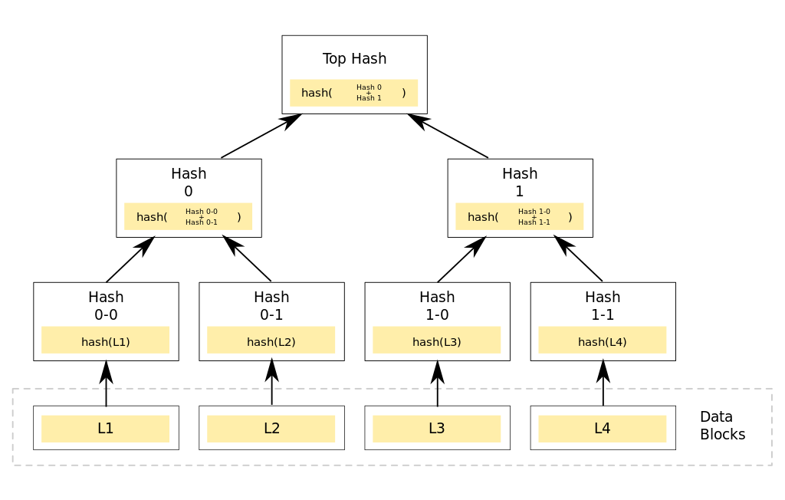
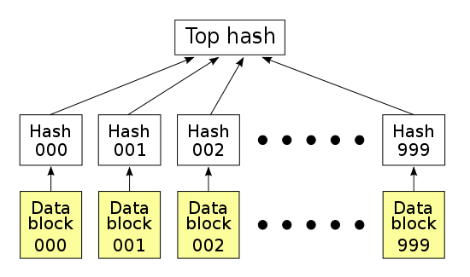
Merkle Tree Vs Hash List

Slide 6
Continued
The main difference from a hash list is that one branch of the hash tree can be downloaded at a time and the integrity of each branch can be checked immediately, even though the whole tree is not available yet.

Slide 7
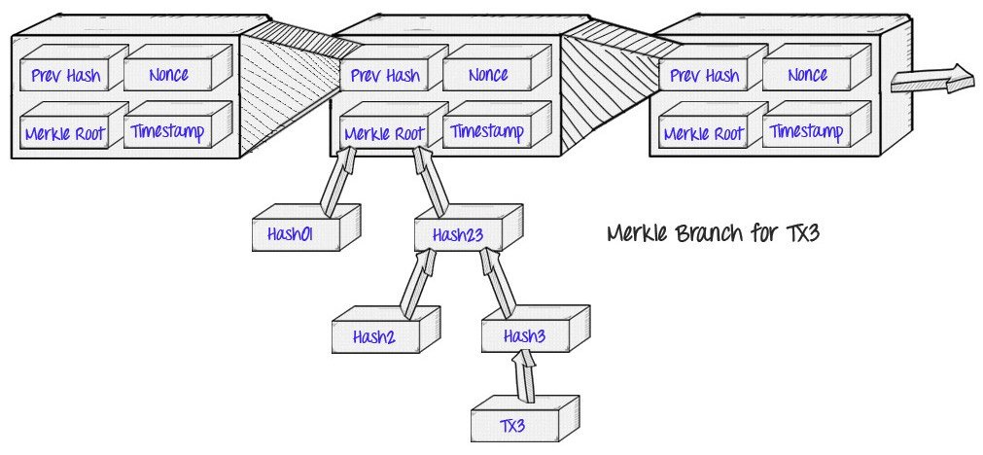
Where in Blockchain?

Slide 8
Continued
Merkle roots do not verify transactions, they verify a set of transactions.
Transaction ID's are hashes of the transaction, and the Merkle tree is constructed from these hashes.
It means that if a single detail in any of the transactions changes, so does the Merkle root. It also means that if the exact same transactions are listed in a different order, the Merkle root will also change.

Slide 9
References
An Efficient Merkle-Tree-Based Authentication Scheme for Smart Grid
Hongwei Li, Member, IEEE, Rongxing Lu, Member, IEEE, Liang Zhou, Member, IEEE, Bo Yang, Member, IEEE, and Xuemin (Sherman) Shen, Fellow, IEEE
Ethereum White Paper
By Vitalik Buterin

Slide 10
Continued
A Critical Review of Blockchain and Its Current Applications
Bayu Adhi Tama, Bruno Joachim Kweka, Youngho Park, Kyung-Hyune Rhee

